Slide 1

M.Sc. Data Science Semester – VI CC-314 & CC-315 Mini Project-I
Roll No. | 07
Name | Zurin Lakdawala
Title | Agricultural Crop Recommendation System using Machine Learning
Mentor’s Name | Dr.Vaidehi Vaghela
Department of AIML and Data Science School of Emerging Science & Technology Gujarat University

Slide 2
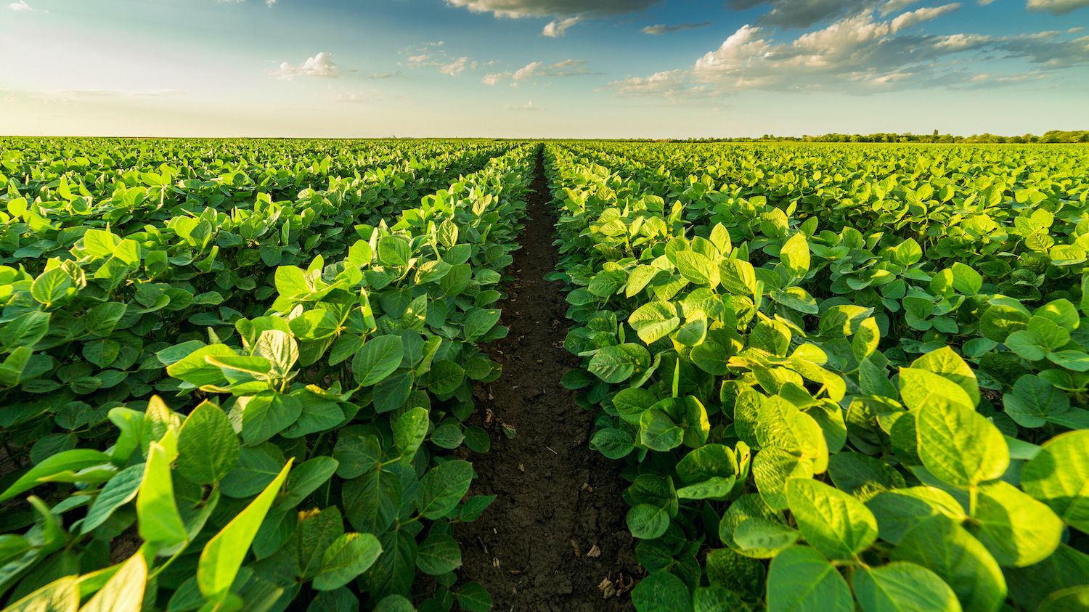
Agriculture crop recommendation system using machine Learning

Slide 3
Table of contents
01
02
03
Introduction
Literature Review
Methodology
04
05
06
Result
Conclusion
References

Slide 4
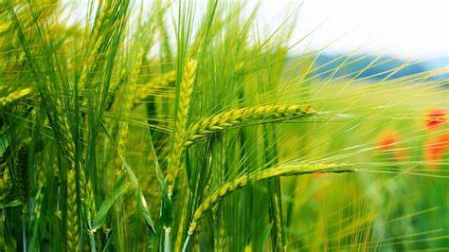
INTRODUCTION
Agriculture is the one amongst the substantial area of interest to society since a large portion of food is produced by them.
Currently, many countries still experience hunger because of the shortfall or absence of food with a growing population.Farmers encounter challenges in selecting the most suitable crops for their land.
Hence, crop protection land assessment and crop yield prediction are of more considerable significance to global food production.
We have noticed in present times that the climate is changing persistently which is harmful to the crops and leading farmers towards debts and suicide.
These risks can be minimized when various mathematical or statistical methods are applied to data and by using these methods, we can recommend the best crop to the farmer for his Agricultural land so that it helps him to get maximum profit.

Slide 5
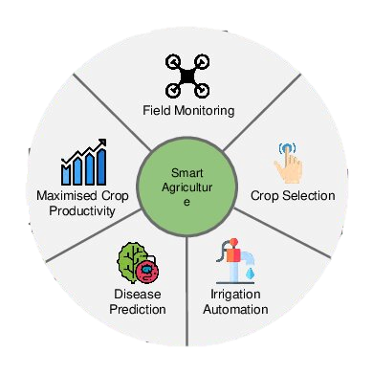
Precision Farming
Nowadays, agriculture in India has witnessed significant advancements, with precision agriculture.
Precision farming, also known as precision agriculture, is an approach to farming that utilizes various technologies, data analytics, and management practices to optimize the efficiency, productivity, and sustainability of agricultural production.
In precision farming, farmers make use of technologies such as GPS, sensors, drones, satellite imagery, and data analytics to gather detailed information about soil variability, weather patterns, crop health, and other relevant factors.
This data is then analyzed to make informed decisions about crop selection , Disease Prediction, maximised crop productivity,resource allocation.

Slide 6
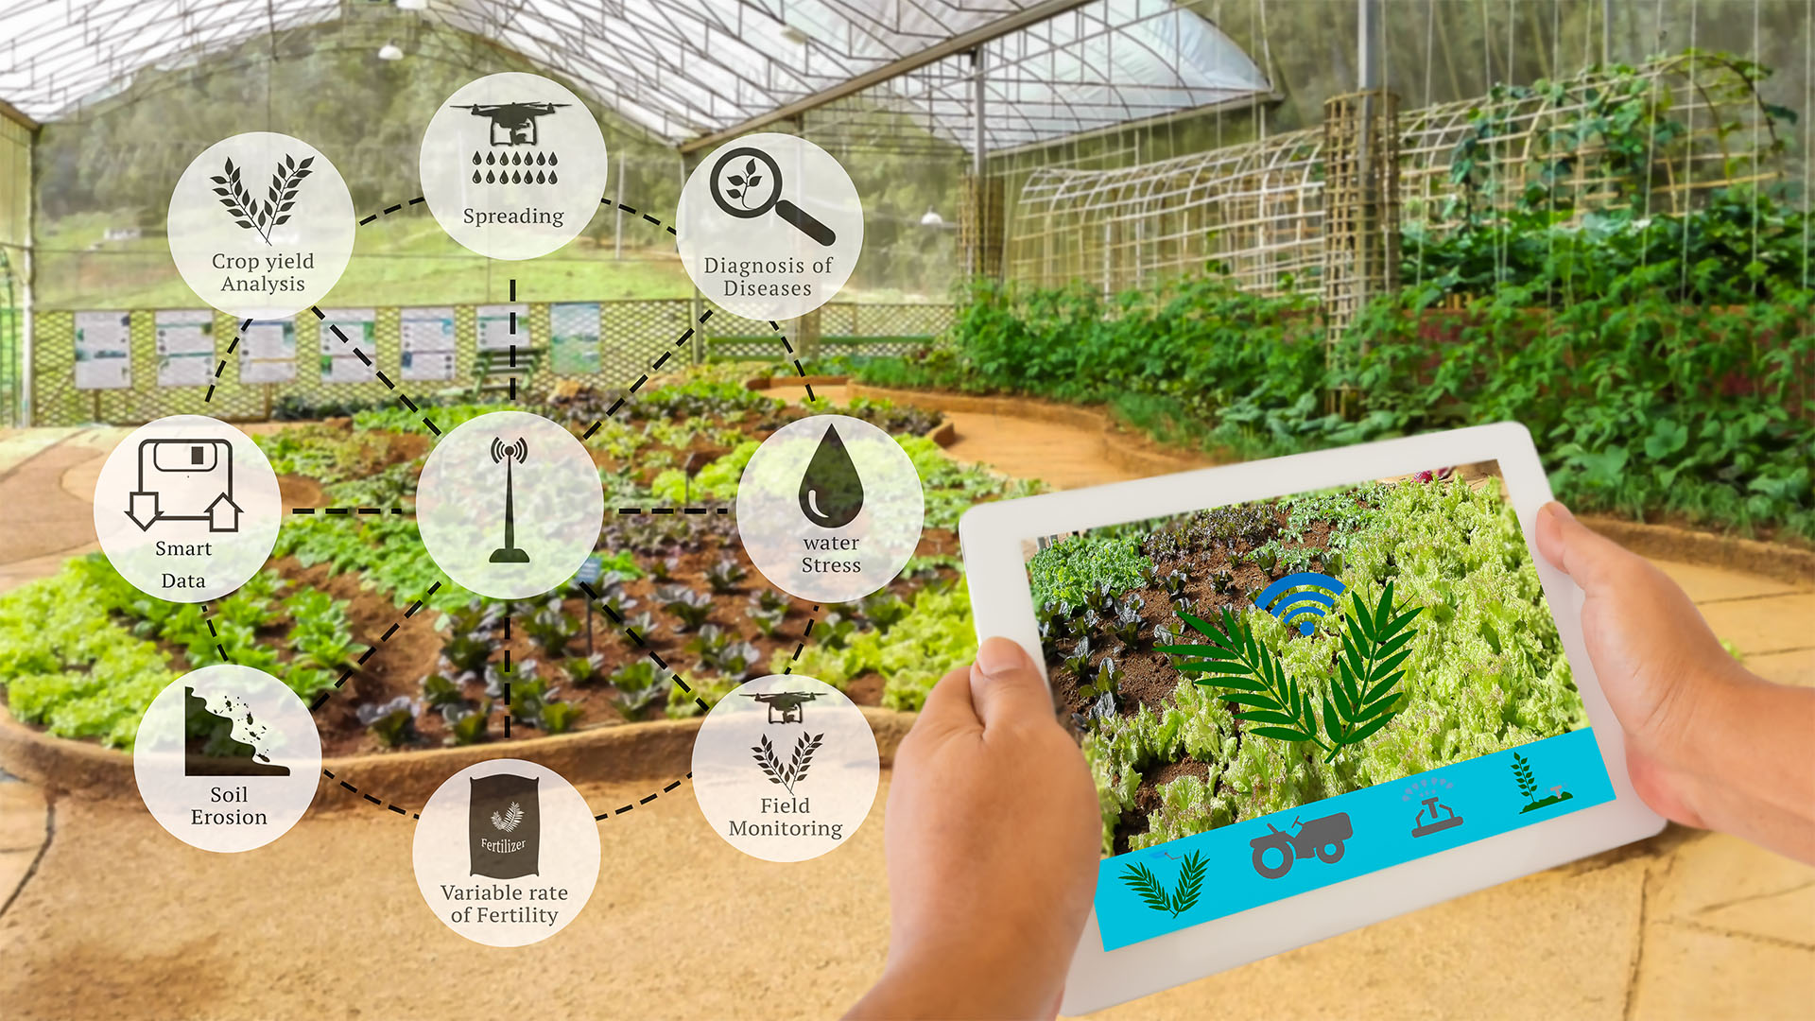
Precision Farming
Precision farming offers several benefits, including:
Increased crop yields and quality.
Reduced input costs (such as fertilizers, pesticides, and water).
Improved environmental sustainability by minimizing resource use and reducing pollution.
Enhanced farm profitability through optimized resource allocation and improved efficiency.
Better risk management through data-driven decision-making and real-time monitoring of field conditions.

Slide 7
LITERATURE REVIEW
Gosai et al. (2021) presented a comprehensive study on the development and implementation of a crop recommendation system leveraging machine learning techniques. Published in the International Journal of Scientific Research in Computer Science, Engineering, and Information Technology, their research addresses the increasing demand for data-driven decision support tools in agriculture to enhance crop productivity and optimize resource utilization.
Lokhande and Dixit (2022) conducted a study focusing on the development and implementation of a crop recommendation system utilizing machine learning techniques. Their research, published in the International Research Journal of Engineering and Technology (IRJET), addresses the growing need for data-driven decision support tools in agriculture to optimize crop selection and enhance productivity.
Priyadharshini et al. (2021) proposed an innovative approach for intelligent crop recommendation leveraging machine learning techniques. In their paper presented at the 2021 5th International Conference on Computing Methodologies and Communication (ICCMC), the authors addressed the critical need for efficient agricultural decision-making systems to enhance crop productivity and optimize resource utilization.

Slide 8
METHODOLOGY
Data Collection
Model Deployment
Data Preprocessing
Feature Selection
Model Selection
Model Evaluation
Model Training

Slide 9
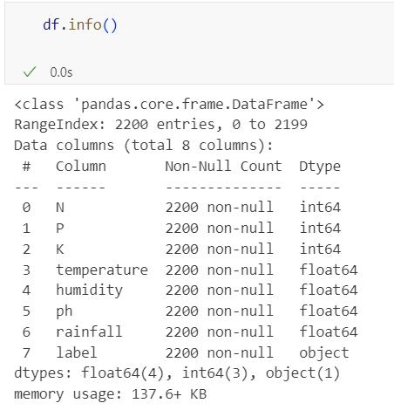
Data Collection
The datasets have been obtained from the Kaggle website. The data set has 2200 instance or data that have taken from the past historic data.
The dataset consists of features like Nitrogen(N), Phosphorous(P), Pottasium(K), PH value of soil, Humidity, Temperature and Rainfall.
This dataset include eleven different crops (labels) such as rice, maize, chickpea, kidneybeans, pigeonpeas, mothbeans, mungbean, blackgram, lentil, pomegranate, banana, mango, grapes, watermelon, muskmelon, apple, orange, papaya, coconut, cotton, jute, and coffee.

Slide 10
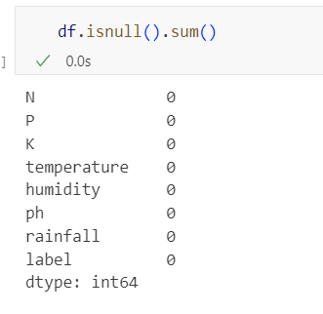
Data Preprocessing
1) Check the Missing Values
One of the first steps is in data preprocessing is to make sure that the dataset we are using is accurate. The dataset should not have any missing values and if the dataset does have missing values, they should be replaced by the appropriate values. The dataset which we are using does not have any missing values

Slide 11
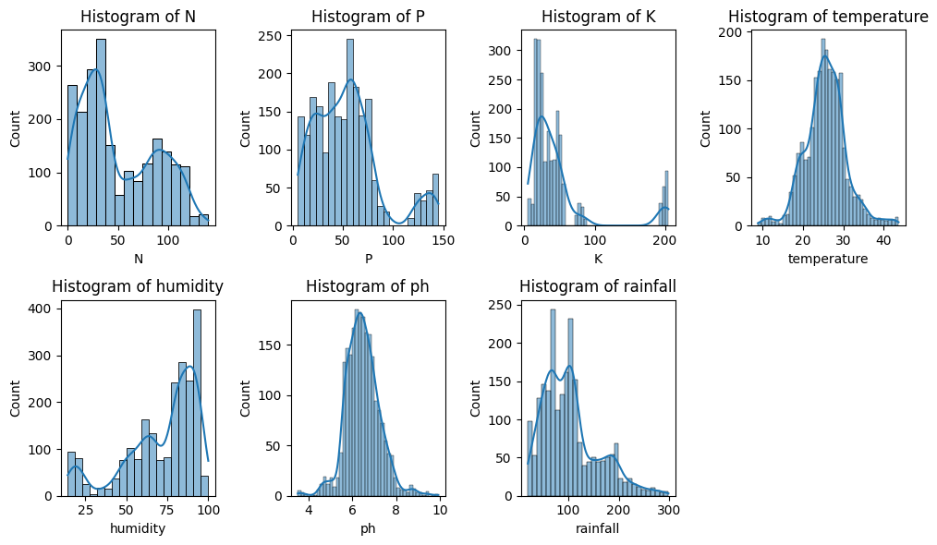
Data Preprocessing
2) Normally distributed
The data should also be checked to see if there is a normal distribution for its features.

Slide 12
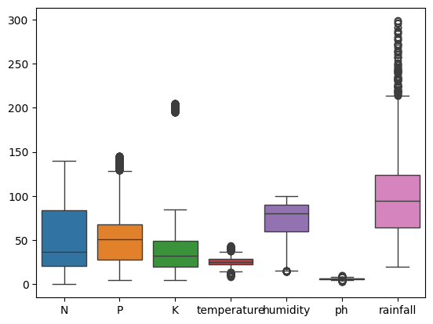
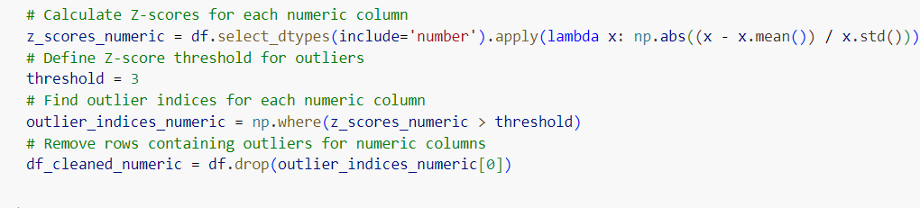
Data Preprocessing
3) Check the outliers and remove that outliers
Outliers are present in multiple features of the dataset, with "K" having the highest count, followed by "temperature," "ph," and "rainfall.“
Remove the outliers

Slide 13
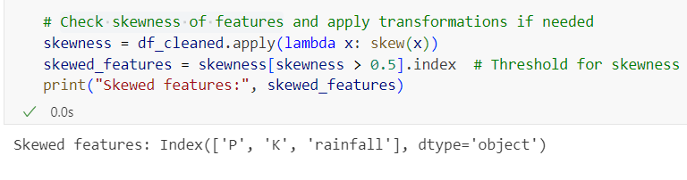
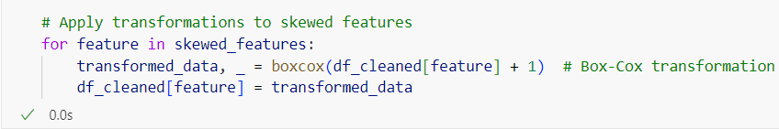
Data Preprocessing
4) Check Skewness of Features
Apply tranformations to skewed features

Slide 14
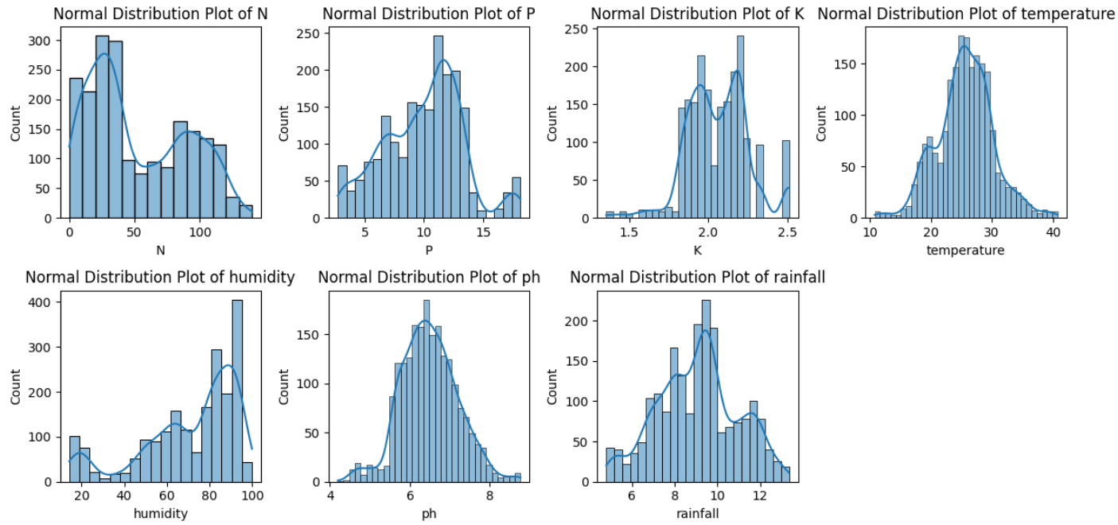
Data Preprocessing
Normal Distribution Plots After Data Preprocessing

Slide 15
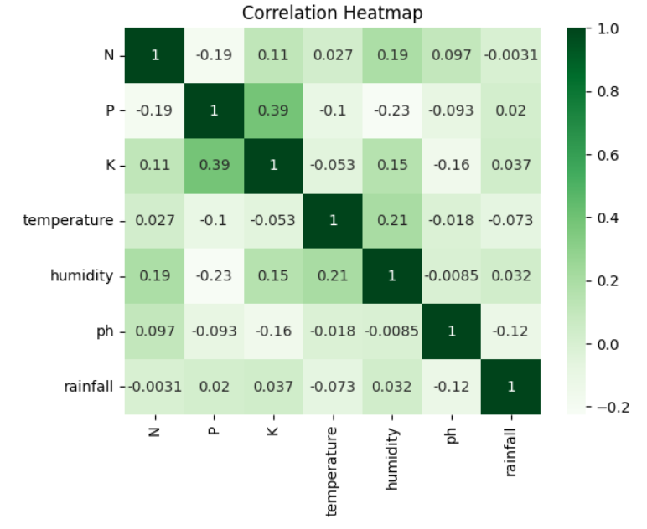
Feature Selection
It is important that we select only those features that will be necessary to determine the type of crop to grow. For this, we have created a correlation matrix that shows the linear relationship of a feature with every other features.
If features are highly correlated then that feature should be dropped, but as we can see in the matrix that the features are not highly correlated with each other, hence it makes sense not to drop any of them and hence we will be using all of them to predict the type of crop to grow.

Slide 16
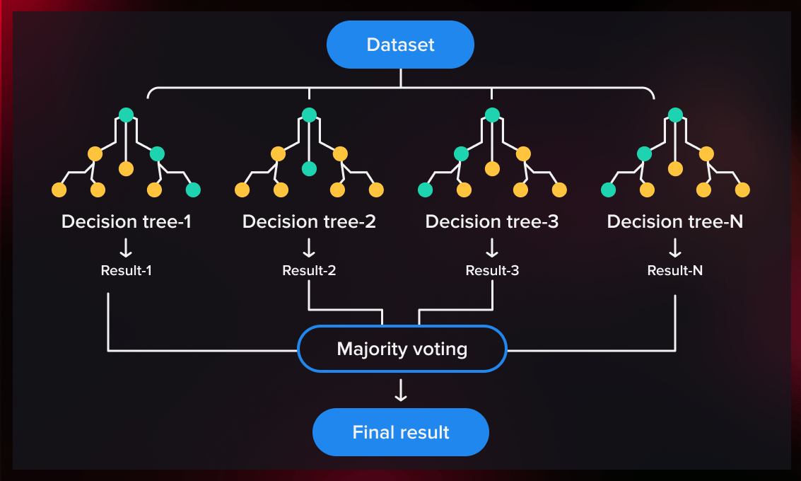
Model Selection
1) Random Forest
Random Forest is a powerful supervised ensemble machine learning algorithm employed in both classification and regression tasks. It operates by aggregating the predictions of multiple decision trees to produce a final output. This aggregation process helps to improve the accuracy and robustness of predictions.
At its core, Random Forest is based on the concept of bagging (Bootstrap Aggregating). Bagging involves creating multiple decision trees, each trained on a random subset of the training data with replacement.
And the random forest takes the predictions from each tree and predicts the final output based on the majority vote of predictions
One of the key advantages of Random Forest is its ability to mitigate the risk of overfitting, a common issue with individual decision trees.

Slide 17
Model Selection
2) Naive Bayes Classifier
Naive Bayes is a statistical classification technique based on Bayes Theorem.
It is one of the simplest supervised learning algorithms. Naive Bayes classifier is the fast, accurate and reliable algorithm.
Naive Bayes classifiers have high accuracy and speed on large datasets.
Naive Bayes classifier assumes that the effect of a particular feature in a class is independent of other features.
Working of naive bayes classifier
convert the given dataset into frequency tables.
Generate Likelihood table by finding the probabilities of given features.
Now, use Bayes theorem to calculate the posterior probability

Slide 18
Example Of Naive Bayes Classifier
Convert the given dataset into frequency tables.
3. Now, use Bayes theorem to calculate the
probability.
Weather | Yes | No
Overcast | 5 | 0
Rainy | 2 | 2
Sunny | 3 | 2
Total | 10 | 5
P(Yes|Sunny)= P(Sunny|Yes)*P(Yes)/P(Sunny)
P(Sunny|Yes)= 3/10= 0.3
P(Sunny)= 0.35
P(Yes)=0.71
So P(Yes|Sunny) = 0.3*0.71/0.35= 0.60
P(No|Sunny)= P(Sunny|No)*P(No)/P(Sunny)
P(Sunny|NO)= 2/4=0.5
P(No)= 0.29
P(Sunny)= 0.35
So P(No|Sunny)= 0.5*0.29/0.35 = 0.41
So as we can see from the above calculation that P(Yes|Sunny)>P(No|Sunny)
Hence on a Sunny day, Player can play the
game.
2. Generate Likelihood table by finding the probabilities of given features.
Weather | No | Yes
Overcast | 0 | 5 | 5/14= 0.35
Rainy | 2 | 2 | 4/14=0.29
Sunny | 2 | 3 | 5/14=0.35
All | 4/14=0.29 | 10/14=0.71

Slide 19
Model Evaluation
Accuracy
Accuracy is a metric used to evaluate the overall performance of a classification model. It represents the proportion of correctly classified instances among all instances in the dataset.
Accuracy = (TP + TN)
(TP + TN + FP + FN)
TP is the number of true positives, TN is the number of true negatives, FP is the number of false positives, and FN is the number of false negatives.
2) Precision:
The proportion of true positive predictions among all positive predictions. It measures the model’s ability to avoid false positives.
Precision = TP
(TP + FP).

Slide 20
Model Evaluation
3) Recall
Recall, also known as sensitivity or true positive rate, is a metric used to evaluate the ability of a classification model to correctly identify all positive instances in the dataset.
It is calculated as the ratio of true positives (correctly predicted positive instances) to the sum of true positives and false negatives (positive instances incorrectly predicted as negative).
Recall = TP
(TP + FN)
4) F1- Score
F1 score is a metric that combines both precision and recall into a single value, providing a balance between the two. It is particularly useful in situations where there is an imbalance between the classes in the dataset.
F1 = 2 * (precision * recall)
(precision + recall)

Slide 21
Model Deployment
Streamlit: An app framework that turns data scripts into shareable web apps in minutes. Used for deploying the Crop Recommendation model.
Deployment Process: Model Integration: The trained Random Forest are integrated into the Streamlit app.
User Interface: A user-friendly interface is crafted for farmers to input the levels of Nitrogen (N), Phosphorous (P), Potassium (K), soil pH value, humidity, temperature, and rainfall. These parameters are utilized by the models to generate personalized crop recommendations

Slide 22
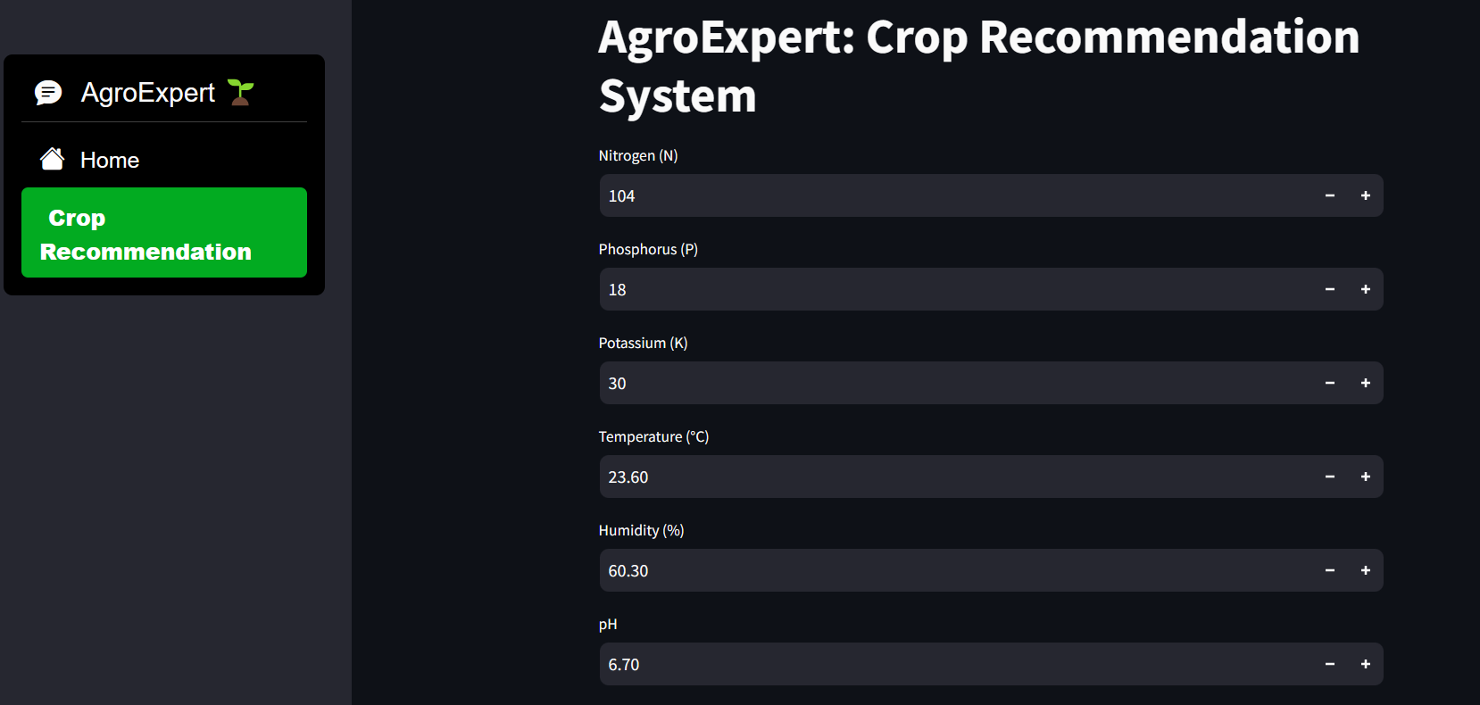
Agricultural Crop Recommendation System using Machine Learning website

Slide 23
RESULT
 | Random Forest | Naïve Bayes
Accuracy | 0.995 | 0.990
Precision | 0.995 | 0.992
Recall | 0.995 | 0.990
F1-score | 0.995 | 0.990
The accuracy of the random forest algorithm is highest with 99.00 %. Thus at last we take this algorithm to use in our model building and final implementation of our project as a website.

Slide 24
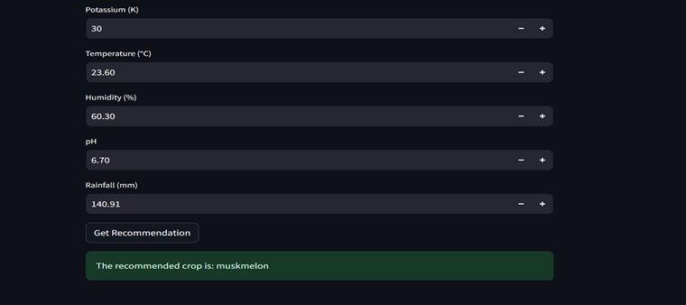
RESULT
Recommendation result of our website

Slide 25

CONCLUSION
In conclusion, This system would help the farmers in making an informed decision about which crop to grow depending on some parameters like Nitrogen, Phosphorous, Pottasium, PH Value, Humidity, Temperature, and Rainfall. By using this we can increase productivity of the country and produce profit out of such a technique. In this manner the farmer’s can plant the right crop increasing his yield and also increasing the overall profitability of the country.

Slide 26
REFERENCES
Gosai, D., Raval, C., Nayak, R., Jayswal, H., & Patel, A. (2021). Crop recommendation system using machine learning. International Journal of Scientific Research in Computer Science, Engineering and Information Technology, 7(3), 558-569.
Lokhande, A., & Dixit, M. (2022). Crop Recommendation System Using Machine Learning. International Research Journal of Engineering and Technology (IRJET), 9(5), 2395-0056.
Priyadharshini, A., Chakraborty, S., Kumar, A., & Pooniwala, O. R. (2021, April). Intelligent crop recommendation system using machine learning. In 2021 5th international conference on computing methodologies and communication (ICCMC) (pp. 843-848). IEEE.
https://www.kaggle.com/datasets/atharvaingle/crop recommendation-dataset

Slide 27

THANK YOU…

